Slide 1
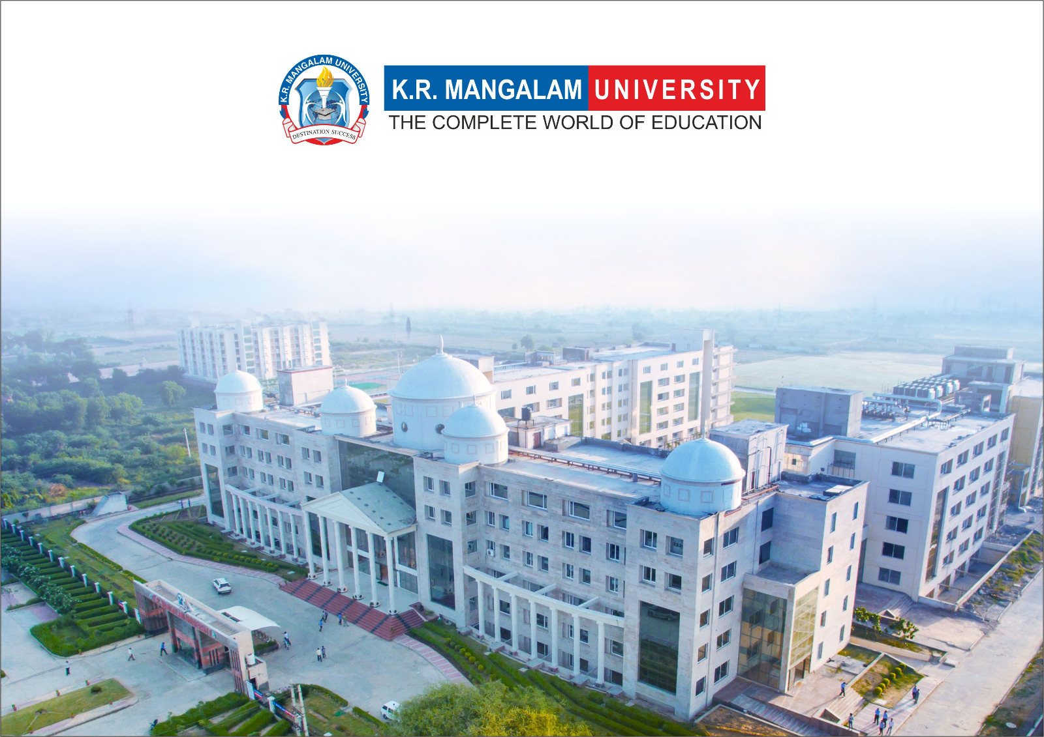

Maker’s Lab Report Presentation
Project-Name: N.A.V.R.A.A.H
Project Category: IoT
Submitted in partial fulfilment of the requirement of the degree of
Bachelor of Technology
in
Computer and Software Engineering
Submitted by Team - A

Slide 2
Introduction
Project Title
N.A.V.R.A.A.H: Navigation Assistant for Visually Restricted And Aided Humans
Sem-II - Project Synopsis
Submitted By
Student Name | Roll number
Rishita | 2501010228
Krishyangi Dixit | 2501010156
Ishan Rawat | 2501010153
Harsh Dev Jha | 2501010168
Manas Bhasker | 2501010226
Faculty Mentor:
Gaurav Verma
1

Slide 3
TEAM CONTRIBUTION
Student Name | Roles Alloted
Rishita | Hardware integration and sensor setup
Manas Bhasker | Camera configuration and OpenCV processing
Harsh Dev Jha | Machine learning model integration
Ishan Rawat | Audio output and alert logic
Krishyangi Dixit | Testing, documentation, and presentation
Faculty Mentor:
Gaurav Verma
1

Slide 4
Abstract
Visually impaired individuals face significant challenges while navigating unfamiliar and dynamic environments. Traditional mobility aids such as white canes provide limited environmental awareness and cannot identify obstacles or suggest directional movement. N.A.V.R.A.A.H is an intelligent assistive navigation system designed to enhance mobility and safety for visually restricted individuals.
The system integrates computer vision, distance sensors, and voice feedback to detect obstacles, identify objects, and provide real-time navigation assistance. NAVRAAH is compact, affordable, and capable of offline operation, making it suitable for everyday use.
2

Slide 5
Introduction
Navigation is a major challenge for visually restricted individuals, especially in unfamiliar surroundings. Existing assistive tools are often expensive, bulky, or complex to operate. With recent advancements in embedded systems and artificial intelligence, it has become possible to design compact and efficient navigation aids.
NAVRAAH aims to utilize these technologies to provide a simple, reliable, and cost-effective assistive navigation solution that improves user independence and safety.
3

Slide 6
Problem Statement
Visually restricted individuals experience difficulties in detecting obstacles, identifying objects, and deciding safe movement directions. Conventional aids provide limited environmental awareness and lack intelligent guidance.
There is a need for an affordable, portable, and intelligent navigation system that can assist visually restricted users in real time without relying on internet connectivity.
4

Slide 7
Objectives
The objectives of the NAVRAAH project are as follows:
• To detect obstacles in front of the user
• To identify common objects such as people, chairs, walls, and stairs
• To measure the distance between the user and obstacles
• To provide left or right navigation guidance
• To generate voice and vibration alerts
• To design a compact and user-friendly wearable device
5

Slide 8
Proposed System
NAVRAAH is a Raspberry Pi–based embedded assistive system that integrates a camera module, distance sensors, and audio output. The camera captures real-time visual data, which is processed using machine learning models to identify objects.
Distance sensors calculate the proximity of obstacles. Based on this information, the system generates spoken navigation instructions and vibration alerts to guide the user safely.
5

Slide 9
SYSTEM ARCHITECTURE
Input Layer:
Camera module and distance sensors for environmental data acquisition
Processing Layer:
Raspberry Pi running image processing and machine learning algorithms
Output Layer:
Speaker and vibration motor for real-time user feedback
5

Slide 10
HARDWARE COMPONENTS
The hardware components used in NAVRAAH include:
• Raspberry Pi Zero 2 W – Central processing and control unit
• MicroSD Card (16–32 GB) – Operating system and program storage
• Camera Module – Real-time image and video capture
• Ultrasonic Sensor / Laser ToF Sensor – Distance and obstacle measurement
• Speaker / Earphones – Voice-based navigation feedback
• Audio Driver / Amplifier Module – Audio signal amplification (if speaker is used)
• Vibration Motor – Tactile alert generation
• Li-ion Battery – Portable power supply
• Battery Charging and Protection Module – Safe charging and power regulation
• Power Switch / Push Button – System ON/OFF control
• Jumper Wires and Connectors – Hardware interconnections
• Compact Wearable Enclosure – Protective casing for the device
5

Slide 11
SOFTWARE REQUIREMENTS
The NAVRAAH system uses open-source software tools and libraries, ensuring no additional licensing cost and easy deployment in an academic environment.
• Operating System: Raspberry Pi OS
• Programming Language: Python
• Image Processing Library: OpenCV
• Machine Learning Framework: TensorFlow Lite
• Object Detection Models: Pre-trained lightweight models
• Audio Output: Text-to-Speech (Offline)
• Development Environment: Thonny / VS Code
5

Slide 12
WORKING OF NAVRAAH
The camera continuously captures the surrounding environment. Machine learning models analyze the video frames to detect and identify objects. Distance sensors measure the proximity of obstacles.
The Raspberry Pi processes this information and determines appropriate navigation instructions. Voice commands and vibration alerts are then generated to guide the user safely.
5

Slide 13
APPLICATION OF NAVRAAH
NAVRAAH can be used in the following areas:
• Assistive navigation for visually restricted individuals
• Smart wearable mobility aid
• Rehabilitation and healthcare environments
• Assistive technology research and development
5

Slide 14
ADVANTAGES OF NAVRAAH
The advantages of NAVRAAH include:
• Affordable and portable design
• Real-time navigation assistance
• Offline functionality
• Easy to use and wearable
• Enhances user independence and safety
5

Slide 15
LIMITATIONS OF NAVRAAH
Despite its advantages, NAVRAAH has certain limitations:
• Reduced accuracy in low-light conditions
• Limited object categories
• Reactive navigation without route planning
5

Slide 16
FUTURE SCOPE OF NAVRAAH
Future enhancements to NAVRAAH may include:
• GPS-based outdoor navigation
• Improved depth sensing technology
• Mobile application integration
• Advanced AI model optimization
• Improved battery efficiency
5

Slide 17
Project Timeline
Week | Task
Weeks 1-3 | Problem identification, requirement analysis, and literature survey
Weeks 4-5 | Hardware selection, component procurement, and system design
Weeks 6-9 | Camera setup, sensor integration, and Raspberry Pi configuration ; Implementation of object detection and distance measurement logic
Weeks 10-11 | Voice feedback, vibration alerts, and system integration
Weeks 12-14 | Testing, optimization, and performance evaluation
10

Slide 18
CONCLUSION
N.A.V.R.A.A.H demonstrates how artificial intelligence and embedded systems can be effectively used to improve the mobility and safety of visually restricted individuals. By integrating computer vision, distance sensing, and audio feedback, the project provides a practical, affordable, and scalable assistive navigation solution.
5

Slide 19
THANK YOU
11

